Slide 1
Mining and Mineral Exploration

Slide 2
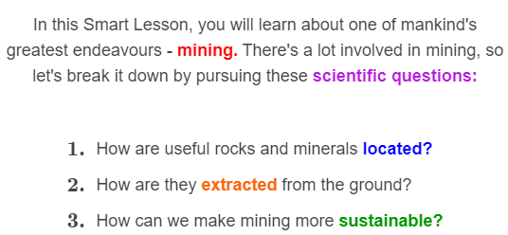
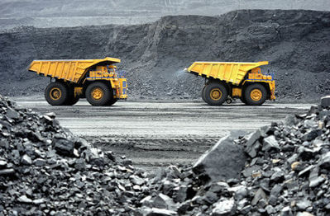

Slide 3
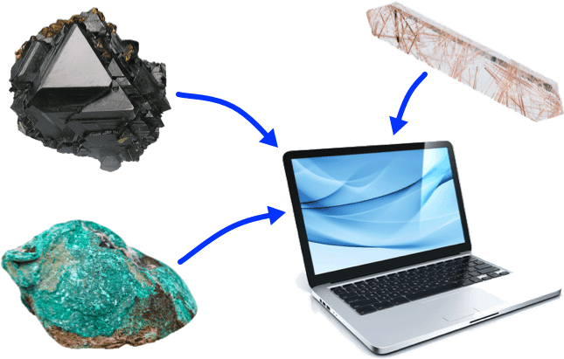
Consider this question, for starters. Where did all the metal parts of the computer you're using come from?
If you said, "From the ground," you're absolutely right! Metals such as iron, copper and titanium are all taken out of rocks. How cool is that?

Slide 4
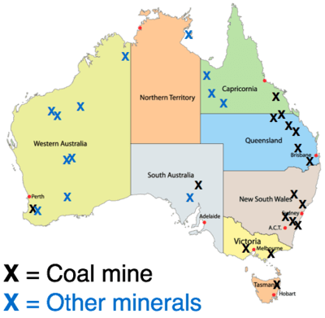
Australia has many useful resources that can be mined, including coal, gold, uranium, copper, iron ore, nickel, silver and bauxite.
Mining is the process of taking these resources out of the ground, or extracting them.

Slide 5

The first step in mining is to work out where the minerals are that contain the metals you want.
This process is called mineral exploration.

Slide 6
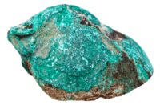
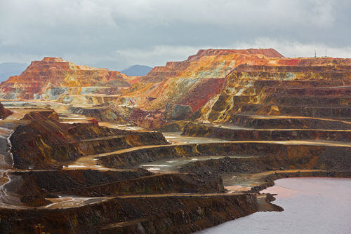
To work out where to start mining, geologists can look for certain colours associated with specific minerals. For example, copper has a blue or green colour that is easy to spot in ore rocks (right). Other minerals produce red or yellow colours, as you can see in the Spanish mine below:

Slide 7
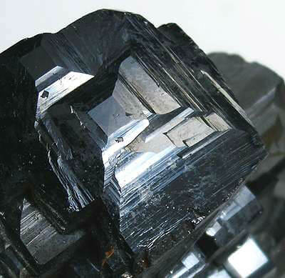
Minerals that contain iron, nickel or cobalt can be detected because of their magnetic properties; they stick to a magnet!
The mineral below is even called magnetite. Its properties can be explained using physics; the field of science that's all about forces, motion and magnetism.

Slide 8
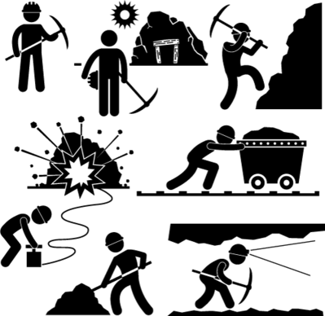
Mining is the process of removing minerals from the ground after they have been found by geologists.
There are different methods of mining, depending on how close the mineral ore is to the surface and what type of rocks are above it. Two common types of mining are opencast mining and underground mining.

Slide 9
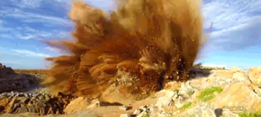
Opencast mining (or opencut mining) is used to extract minerals that are close to the surface.
The ore rocks are exposed by digging a large pit, then explosives are used to break them into manageable pieces! Trucks transport the ores out of the mine, so they can be processed elsewhere.

Slide 10
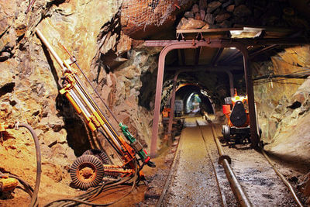
Underground mining is used when the mineral ores are deep below the surface.
Tunnels are dug out to reach an ore deposit. They can go as deep as 4 kilometres into the ground! The temperature tends to be quite high at this depth.

Slide 11

Underground mining is more dangerous than opencast mining, because of the risks of flooding, gas leaks, explosions or tunnels caving in.
If there are so many hazards, why should people dig into the Earth at all?

Slide 12
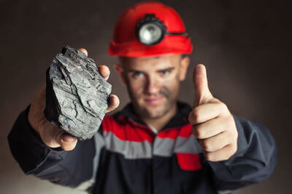
One thing we dig for is coal.
Coal is an extremely useful resource. It provides over 65% of Australia's electricity, but is also used for heating homes and to produce the steel in buildings!

Slide 13
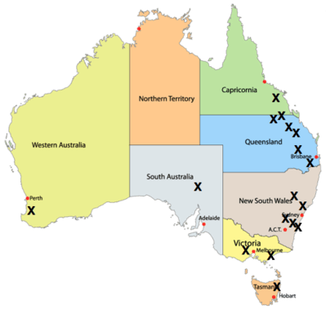
This map shows where major coal mines (X) are found in Australia. Most of them are around the east coast, close to where the big cities are:

Slide 14
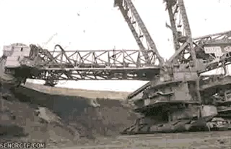
Coal isn't actually a mineral, but it can still be mined with opencast or underground mining techniques.
Opencast coal mining uses giant bucket wheel excavators to expose the coal beneath the surface. These excavators can be up to 80 metres long; that's almost the length of a football field!

Slide 15
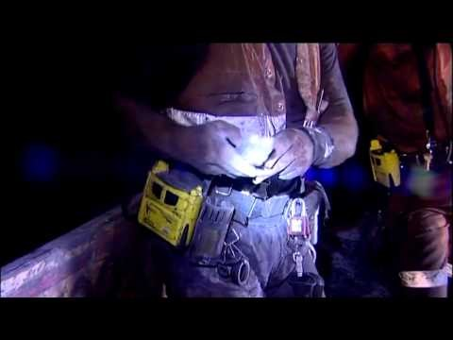

Slide 16
Dredging is another type of mining method.
This method can be used when minerals are found in sand and a large lake can be dug and filled with water.

Slide 17
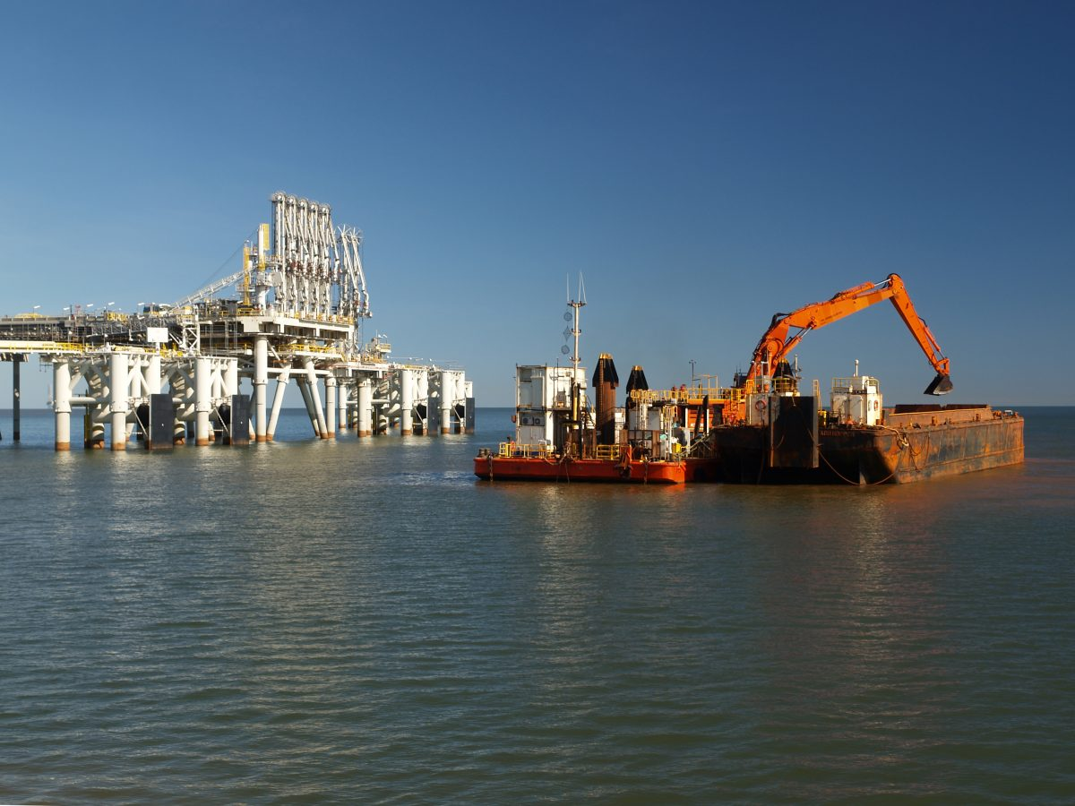
A large pit is dug and filled with water to create a small lake. Then a dredging boat is floated on the surface. As you can see, the boat then uses large hoses to suck up the sand. The minerals are heavier than sand and so are easily separated from it when in water. The sand and the water are then pumped back into the lake.

Slide 18
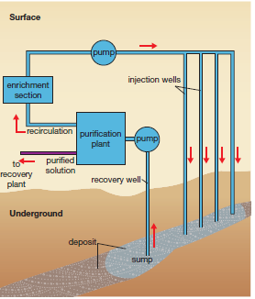
Another type is leach mining.
Some materials can be mined by dissolving them in fluid that is injected into the ore body.
The process begins by drilling bore holes into the ore deposit.
A solution that will dissolve the ore, called a leach solution, is pumped into the ore. The dissolved ore in solution is then pumped to the surface through a second bore hole.

